Slide 1


How to: Decision RENEW
A simplified guide on how to probabilistic forecast retrofitting in YOUR house.

Slide 2
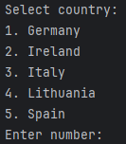
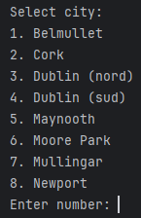
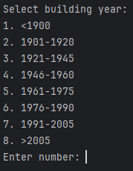
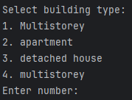

1st Step: go in test.py and Create your House
Country
Age
Stats
Archetype
City

Slide 3
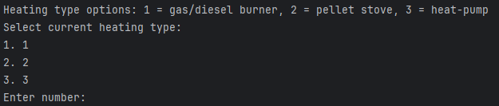
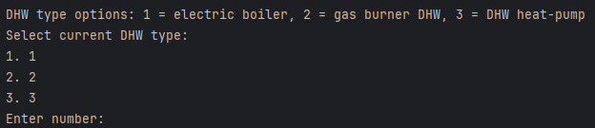
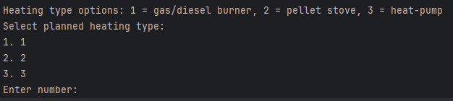
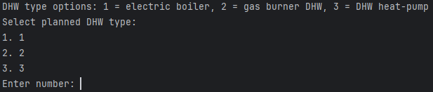
2nd Step: Heating and DHW Systems
Your Current Heating System first:
Then Current Domestic Hot Water System :
Into the Heating System you want to try:
Into the Domestic Hot Water System you want to try:

Slide 4


3rd step: PV panels?

Slide 5
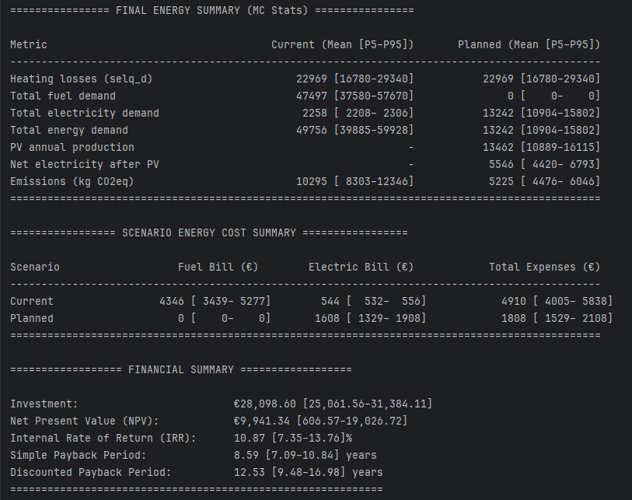
Results: Overview
Energy
Bills
Investment

Slide 6
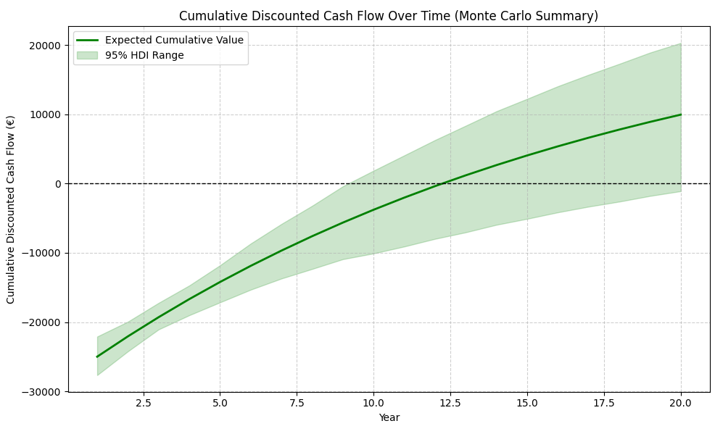
Results: Investment Analysis (with Confidence Bounds)

Slide 7
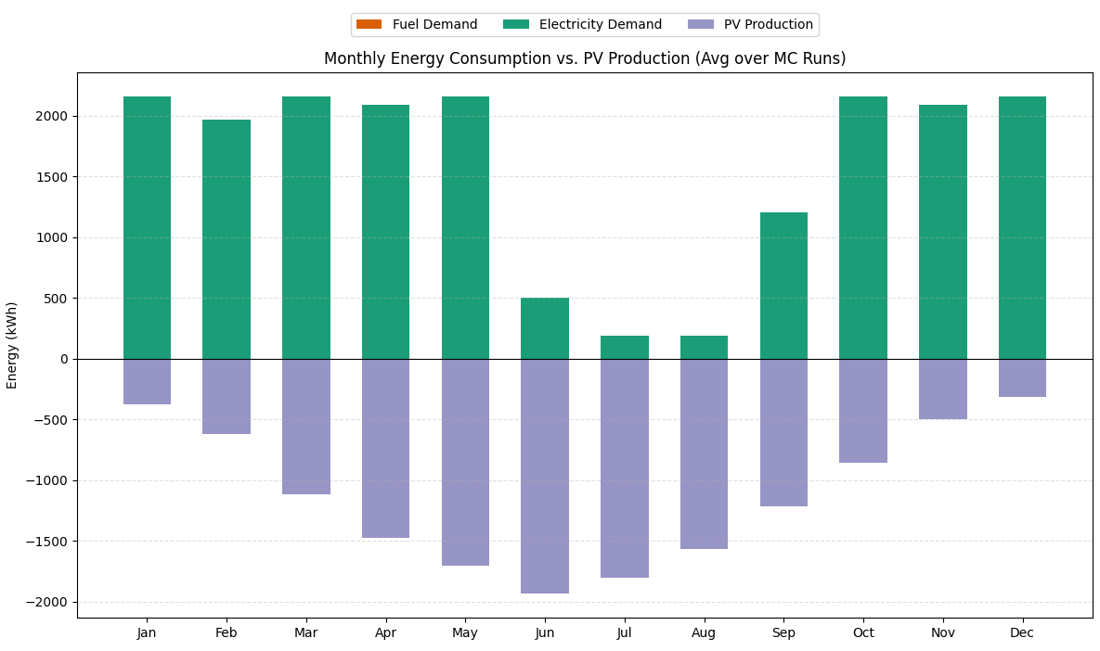
Results: Planned Energy Prosumption

Slide 8
Done!
From the results you can choose of you think the retrofit it’s worth or no with just few clicks.
This gives you even best/worst scenarios too:
Easy to use and applicable across different countries
This was just 1 generic simulation, keep playing around!
Best Case
Worst Case

